Slide 1
CS 310 Operating Systems Lecture 24 Scheduling – FIFO, SJF, SRTF
Ravi Mittal
IIT Goa

Slide 2
In this lecture we will study
Scheduling in Batch System
FIFO
SJF
SRTF

Slide 3
Acknowledgements !
Contents of this class presentation has been taken from various sources. Thanks are due to the original content creators:
CS162, Operating System and Systems Programming, University of California, Berkeley
Book: Modern Operating Systems, Andrew Tenenbaum, and Herbert Bos, 4th Edition, Pearson

Slide 4
Reading
Book: Modern Operating Systems, Andrew Tenenbaum, and Herbert Bos, 4th Edition, Pearson
Chapter 2

Slide 5
Last Class

Slide 6
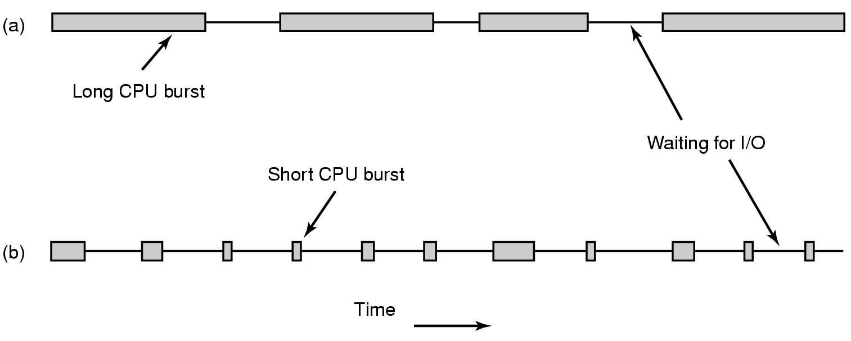
CPU Bursts
CPU-bound process
I/O-bound proces
As processors become faster, processes tend to become more I/O bound
Why?
CPU is becoming faster than the I?O
Adapted from: Tanenbaum, Modern Operating Systems

Slide 7
Non-preemptive vs Preemptive scheduling
Non-preemptive Scheduling Algorithm
Picks up a process to run
Let the process run until it blocks (for I/O or waiting for another process) or voluntarily releases the CPU
A process may run for hours; it will not be forcibly suspended
No scheduling decisions are made during clock interrupts
Preemptive Scheduling
Picks up a process to run
lets the process run for a maximum of some fixed time
At the end of time period, timer interrupt occurs
In Kernel mode, scheduler picks up another ready process to run
Adapted from: Tanenbaum, Modern Operating Systems

Slide 8
Scheduling Algorithms - types
Different environment require different scheduling algorithms
Different applications have different goals → appropriate scheduling algorithms
Categories of Scheduling Algorithms
Batch
Interactive
Real time (deadlines)
Adapted from: Tanenbaum, Modern Operating Systems

Slide 9
Batch System

Slide 10
Scheduling Policy Goals/Criteria
Minimize Response Time
Time between issuing a command and getting result
Maximize Throughput
Maximize operations (or jobs) per second
Minimize Turnaround time
Average elapsed time – primarily for batch system
Fairness
Share CPU among users in some equitable way

Slide 11
Scheduling in Batch Systems

Slide 12
Scheduling in Batch Systems
First-come First-served (FCFS)
Shortest Job First (SJF)
Shortest Remaining Time First (STRF)
Preemptive version of SJF

Slide 13
First Come First Served

Slide 14
First-Come, First-Served (FCFS) Scheduling
First-Come, First-Served (FCFS)
Also “First In, First Out” (FIFO) or “Run until done”
In Batch systems, FCFS meant one program scheduled until done (including I/O)
In interactive system, means keep CPU until thread blocks
Example: Process Burst Time P₁ 24 P₂ 3 P₃ 3
Suppose processes arrive in the order: P₁ , P₂ , P₃ The Gantt Chart for the schedule is:
Waiting time for P₁ = 0; P₂ = 24; P₃ = 27
Average waiting time: (0 + 24 + 27)/3 = 17
Average Completion time: (24 + 27 + 30)/3 = 27
P₁
P₂
P₃
0
24
27
30
Kubiatowicz CS162 © UCB Fall 2020

Slide 15
First-Come, First-Served (FCFS) Scheduling
Advantages
Simple algorithm
Easy to implement
Disadvantage
Convoy Effect
Kubiatowicz CS162 © UCB Fall 2020

Slide 16
FCFS: Convoy effect
Short process stuck behind long process
Scheduled Task (process, thread)
time
Scheduling queue
Arrivals
With FCFS non-preemptive scheduling, convoys of small tasks tend to build up when a large one is running.
Kubiatowicz CS162 © UCB Fall 2020

Slide 17
FCFS Scheduling (Cont.)
Example continued:
Suppose that processes arrive in order: P2 , P3 , P1 Now, the Gantt chart for the schedule is:
Waiting time for P1 = 6; P2 = 0; P3 = 3
Average waiting time: (6 + 0 + 3)/3 = 3
Average Completion time: (3 + 6 + 30)/3 = 13
In second case:
Average waiting time is much better (before it was 17)
Average completion time is better (before it was 27)
FCFS Pros and Cons:
Simple (+)
Short jobs get stuck behind long ones (-)
Non-preemptive (-)
P₂
P₃
P₁
0
3
6
30
Kubiatowicz CS162 © UCB Fall 2020

Slide 18
Disadvantages of FCFS scheduling
FCFS Scheme: Potentially bad for short jobs!
Depends on submit order
If you are first in line at supermarket with milk, you don’t care who is behind you, on the other hand…

Slide 19
Shortest Job First

Slide 20
Shortest Job First (SJF)
Non-preemptive
Run whatever job has least amount of computation to do
Shortest job first scheduling runs a process to completion before running the next one
Sometimes called “Shortest Time to Completion First” (STCF)
Need to know run times in advance
Provably optimal
4 jobs with runs times of a,b,c,d
First finishes at a, second at a+b,third at a+b+c, last at a+b+c+d
Mean turnaround time is (4a+3b+2c+d)/4
Smallest time has to come first to minimize the mean turnaround time
Kubiatowicz CS162 © UCB Fall 2020

Slide 21
Shortest Remaining Time First

Slide 22
Shortest Remaining Time First (SRTF)
Preemptive version of Shortest job first
If job arrives and has a shorter time to completion than the remaining time on the current job, immediately preempt CPU
Sometimes called “Shortest Remaining Time to Completion First” (SRTCF)
The queue of jobs is sorted by estimated job length so that short programs get to run first and not be held up by long ones
Both SJF and SRTF:
These can be applied to whole program or current CPU burst
Idea is to get short jobs out of the system
Big effect on short jobs, only small effect on long ones
Result is better average response time
Kubiatowicz CS162 © UCB Fall 2020

Slide 23
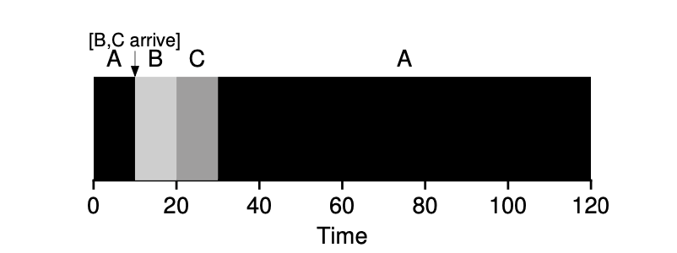
Shortest Remaining Time First (SRTF)
Execution time of A = 100, B = 10, C =10 seconds
A will be preempted when jobs B and C arrive
Average Turn Around Time = 50 seconds
OSTEP Book

Slide 24
Estimating future CPU Burst time
The SRTF algorithm can be applied to whole program or current CPU burst
Sorting based on future burst time?
How do we know it ?
Solution:
Predict future burst based on the past history
Use an estimator function on previous bursts: Let tn-1, tn-2, tn-3, etc. be previous CPU burst lengths. Estimate next burst τn = f(tn-1, tn-2, tn-3, …)
For example: Exponential Averaging
τn = αtn-1+(1-α)τn-1 with (0<α≤1), where
τn : predicted size of the n^{th} CPU burst
tn-1 : the measured time of the (n-1)^{th} burst
α : a weighing factor

Slide 25
Estimating future CPU Burst time
Weighing factor α can be adjusted based on how much to weigh past history versus last observation
If α = 1 then only the last observation of the CPU burst period counts
If α = ½ then the last observation has as much weight as the historical weight

Slide 26
Exponential Average with ⍺ = 0.5, 1, 0.25
Exponential Average (⍺ =0.5)
Exponential Average (⍺ = 1)
Exponential Average (⍺ = 0.25)

Slide 27
Advantages and Disadvantages of SRTF
Advantages
This scheduling is optimal in that it always produces the lowest average response time
Processes with short CPU bursts are given priority and hence run quickly
Disadvantages
Long-burst (CPU-intensive) processes are hurt with a long average waiting time
In fact, if short-burst processes are always available to run, the long-burst ones may never get scheduled
Starvation
the effectiveness of meeting the scheduling criteria relies on our ability to estimate the length of the next CPU burst

Slide 28
Useful metrics
Waiting time for process P: time before P got scheduled
Average waiting time: Average of all processes’ wait time.
Completion time (response time): Waiting time + Run time.
Average completion time (response time): Average of all processes' completion time

Slide 29
Lecture Summary
In Batch Systems, the following scheduling algorithms are used
First Come First Served
Simple, Convoy effect
Shortest Job First
Need to know job length in advance
Shortest Remaining Time First
Preemptive
Performs well - lowest average response time
Long burst job may suffer

Slide 30
Scheduling in Interactive Systems

Slide 31
Scheduling in Interactive Systems
Round Robin
Priority

Slide 32
Round Robin

Slide 33
Round Robin (RR) Scheduling
Uses Preemption!
Each process gets a small unit of CPU time (time quantum), usually 10-100 milliseconds
After quantum expires, the process is preempted and added to the end of the ready queue
n processes in ready queue and time quantum is q
Each process gets 1/n of the CPU time
In chunks of at most q time units
No process waits more than (n-1)q time units

Slide 34
The magic number
What should q be?
q large ⇒ FCFS
q small ⇒ Interleaved
q must be large with respect to context switch, otherwise overhead is too high (all overhead)

Slide 35
Example of RR with Time Quantum = 20
Example: Process Burst Time P₁ 53 P₂ 8 P₃ 68 P₄ 24
The Gantt chart is:
Waiting time for P₁= 0 + (68-20)+(112-88)=72 P₂=(20-0)=20 P₃=(28-0)+(88-48)+(125-108) + 0 =85 P₄=(48-0)+(108-68)=88
Average waiting time = (72+20+85+88)/4=66¼
Average completion time = (125+28+153+112)/4 = 104½
P₁
P₂
P₃
P₄
P₁
P₃
P₄
P₁
P₃
P₃
0
20
28
48
68
88
108
112
125
145
153

Slide 36
Round-Robin Quantum
Assume that context switch overhead is 0
What happens when we decrease q?
Avg. response time always decreases or stays the same
Avg. response time always increases or stays the same
Avg. response time can increase, decrease, or stays the same
Note: Response time: Time between issuing a command and getting result

Slide 37
Decrease Response Time
T₁: Burst Length 10
T₂: Burst Length 1
Q = 10
Average Response Time = (10 + 11)/2 = 10.5
Q = 5
Average Response Time = (6 + 11)/2 = 8.5
T₁
T₂
0
10
11
T₁
T₂
T₁
0
5
6
11

Slide 38
Same Response Time
T1: Burst Length 1
T2: Burst Length 1
Q = 10
Average Response Time = (1 + 2)/2 = 1.5
Q = 1
Average Response Time = (1 + 2)/2 = 1.5
T₁
T₂
0
1
2
T₁
T₂
0
1
2

Slide 39
Increase Response Time
T1: Burst Length 1
T2: Burst Length 1
Q = 1
Average Response Time = (1 + 2)/2 = 1.5
Q = 0.5
Average Response Time = (1.5 + 2)/2 = 1.75
T₁
T₂
0
1
2
0
2

Slide 40
Round-Robin Scheduling: Discussion
How do you choose time slice?
What if too big?
Response time suffers
What if time slice too small?
Throughput suffers!
Actual choices of timeslice:
Initially, UNIX timeslice one second:
Worked ok when UNIX was used by one or two people
Need to balance short-job performance and long-job throughput:
Typical time slice today is between 10ms – 100ms
Typical context-switching overhead is 0.1ms – 1ms
Roughly 1% overhead due to context-switching

Slide 41
Comparisons between FCFS and Round Robin
Assuming zero-cost context-switching time, is RR always better than FCFS?
Simple example: 10 jobs, each take 100s of CPU time RR scheduler quantum of 1s All jobs start at the same time
Completion Times:
Both RR and FCFS finish at the same time
Average completion(response) time is much worse under RR!
Bad when all jobs same length
Also: Cache state must be shared between all jobs with RR but can be devoted to each job with FIFO
Total time for RR longer even for zero-cost switch!
Job # | FIFO | RR
1 | 100 | 991
2 | 200 | 992
… | … | …
9 | 900 | 999
10 | 1000 | 1000

Slide 42
Earlier Example with Different Time Quantum
Best FCFS:
P₂
[8]
P₄
[24]
P₁
[53]
P₃
[68]
0
8
32
85
153
Quantum
P₁
P₂
P₃
P₄
Average
Wait
Time
Best FCFS
32
0
85
8
31¼
Q = 1
84
22
85
57
62
Q = 5
82
20
85
58
61¼
Q = 8
80
8
85
56
57¼
Q = 10
82
10
85
68
61¼
Q = 20
72
20
85
88
66¼
Worst FCFS
68
145
0
121
83½
Completion
Time
Best FCFS
85
8
153
32
69½
Q = 1
137
30
153
81
100½
Q = 5
135
28
153
82
99½
Q = 8
133
16
153
80
95½
Q = 10
135
18
153
92
99½
Q = 20
125
28
153
112
104½
Worst FCFS
121
153
68
145
121¾

Slide 43
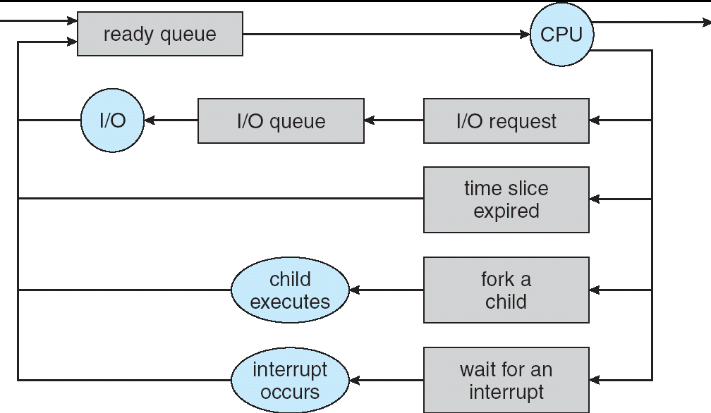
How to Implement RR in the Kernel?
FIFO Queue, as in FCFS
But preempt job after quantum expires, and send it to the back of the queue
How? Timer interrupt!

Slide 44
Priority Scheduling

Slide 45
Round Robin Scheduling – Treat all equal
Round robin scheduling assumes that all processes are equally important
This is not always practical solution
If someone wants
Long CPU intensive process to run with lower priority than interactive processes
Round Robin is not a good solution
What about giving higher priority to Sys Admin processes?

Slide 46
Priority Scheduling
Each process is assigned a priority (a number)
the scheduler simply picks the highest priority (ready) process to run
In preemptive scheduling , a process is preempted whenever a higher priority process is available in the ready queue
In RR or other Scheduling there is one queue of jobs.
Scheduler selects the highest priority process
It takes O(n) time
Solution
Separate queue for each distinct priority
Schedule the process in the highest priority queue

Slide 47
Multilevel Queue Scheduling – Strict Priority
Priority 3
Job 1
Job 2
Job 3
Priority 2
Job 4
Priority 1
Priority 0
Job 5
Job 6
Job 7
Execution Plan
Always execute highest-priority runnable jobs to completion
Each queue can be processed in RR with some time-quantum
A priority is assigned statically to each process, and a process remains in the same queue for the duration of the run time
Problems:
Starvation:
Lower priority jobs don’t get to run because higher priority jobs
Deadlock: Priority Inversion
Happens when low priority task holds a lock needed by high-priority task

Slide 48
Multi level queue: Strict Priority Scheduling: Fairness Issues
Strict fixed-priority scheduling between queues is unfair (run highest, then next, etc):
long running jobs may never get CPU
When you shut down machine, you may find 10-year-old job still waiting to run ??
Must give long-running jobs (with low priority) a fraction of the CPU even when there are higher priority jobs to run

Slide 49
How to implement Fairness
Could give each queue some fraction of the CPU
Could increase priority of jobs that don’t get service
what rate should you increase priorities?
And, as system gets overloaded, no job gets CPU time, so everyone increases in priority
Interactive jobs suffer
Multilevel Feedback Queue

Slide 50
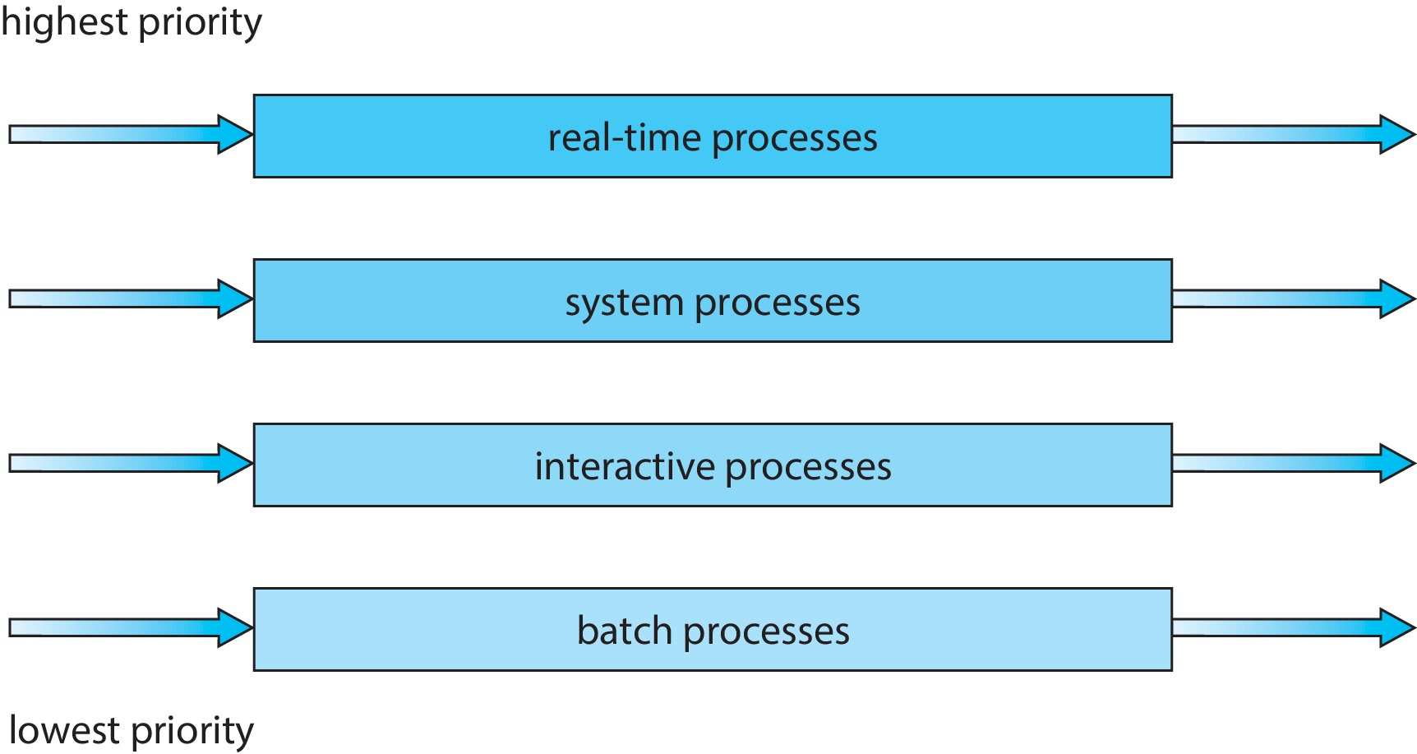
Multilevel Queue Scheduling (for different process types)
Prioritization based upon process type

Slide 51
Types of Resource
Preemptible
OS can take resource away, use it for something else, and give it back later
E.g., CPU
Non-preemptible
Once given resource, it can’t be reused until voluntarily relinquished
E.g., disk space
Given set of resources and set of requests for the resources, types of resource determines how OS manages it

Slide 52
Scheduling Assumptions
Many implicit assumptions for CPU scheduling:
One program per user
One thread per program
Programs are independent
Clearly, these are unrealistic but they simplify the problem so it can be solved
For instance: is “fair” about fairness among users or programs?
If I run one compilation job and you run five, you get five times as much CPU on many operating systems
The high-level goal: Dole out CPU time to optimize some desired parameters of system
USER1
USER2
USER3
USER1
USER2
Time

Slide 53
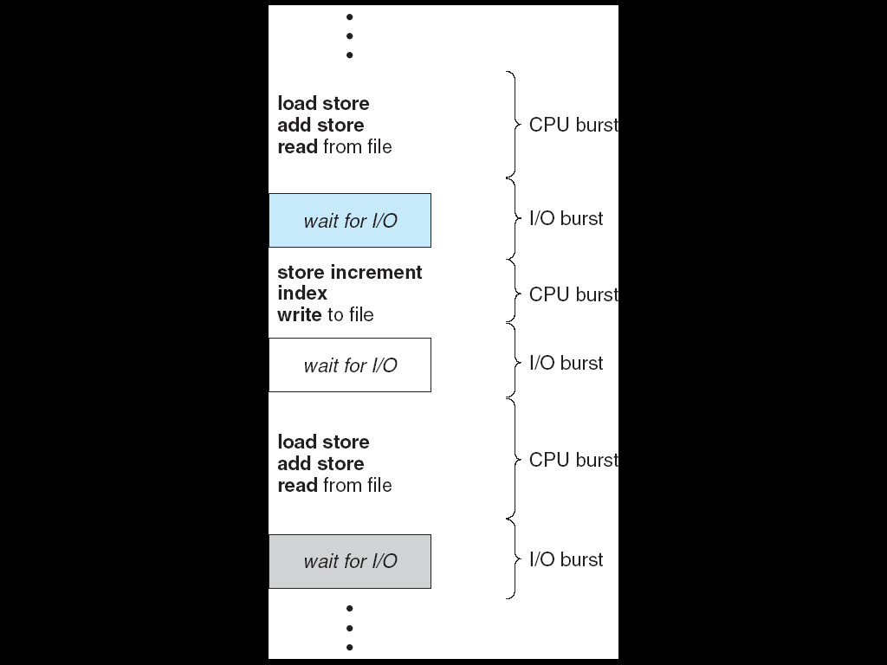
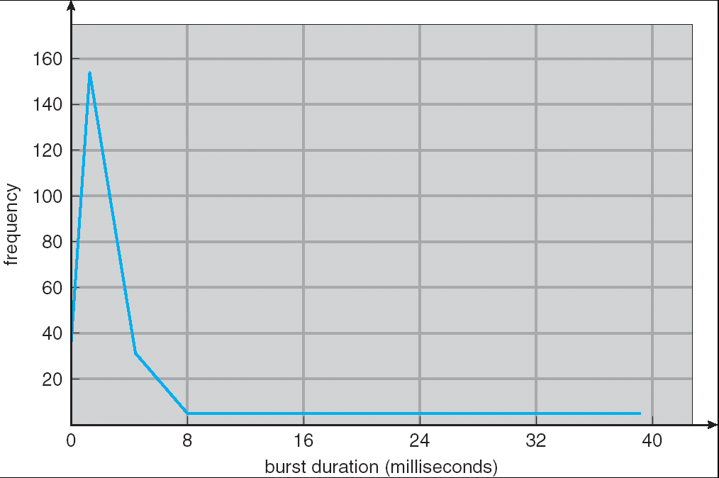
Assumption: CPU Bursts
Weighted toward small bursts
Execution model: programs alternate between bursts of CPU and I/O
Program typically uses the CPU for some period of time, then does I/O, then uses CPU again
Each scheduling decision is about which job to give to the CPU for use in next CPU burst
If a process comes back after I/O wait, it counts as a fresh CPU burst
With time-slicing, thread may be forced to give up CPU before finishing current CPU burst

Slide 54
Lecture Summary
Interactive systems use scheduling that reduce average response time
Round Robin is the oldest, simplest, fairest, and widely used scheduling algorithm
In round robin algorithm, proper choice of time quantum is very important
If the time quantum is too short, there will too many context switches → lower CPU utilization
If the time quantum is too big, there will be high values of wait time and response time → poor response to short interactive requests
Priority scheduling
Multilevel Queue Scheduling – Strict Priority

